Slide 1
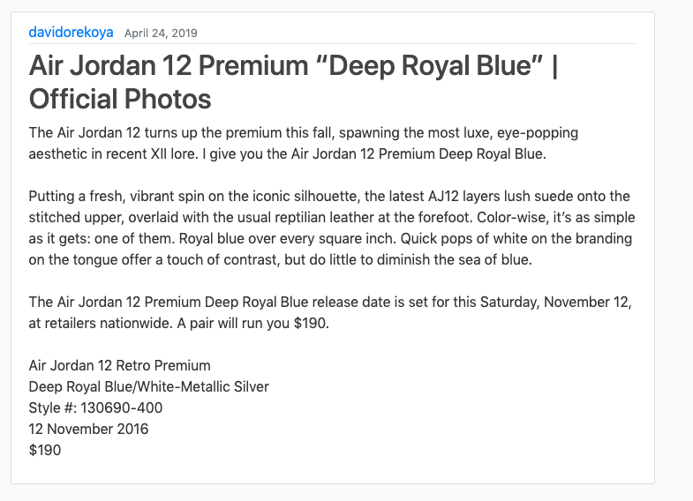

Brand Blog
By : David Orekoya & Mark davenport
Our project is about creating a blog to advertise a brand template using Django to run it.
https://github.com/ksu-is/brand-blog

